Slide 2
beauty
the quality that pleases both the mind and the senses in art or nature
NOT

Slide 3
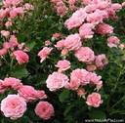
blooming
having flowers; opening into flowers

Slide 4
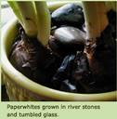
bulbs
round, underground parts from which certain plants grow

Slide 5
doze
to sleep lightly

Slide 6
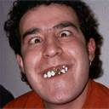
humor
the ability to see or show the funny side of things

Slide 7
recognizing
Identifying; to identify as something or someone previously seen, known

Slide 8
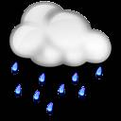
showers
rain that lasts only a short time

Slide 9
sprouting
producing new leaves, shoots, buds; beginning to grow

